Slide 1
An Introduction and Overview of Privacy-Enhancing Technologies for Data Processing and Analysis
22.05.2023, Bachelor Thesis Kick-off Presentation
Jared Fantaye

Slide 2
Outline
Introduction & Motivation
Research Questions
Methodology
Outlook
Timeline

Slide 3
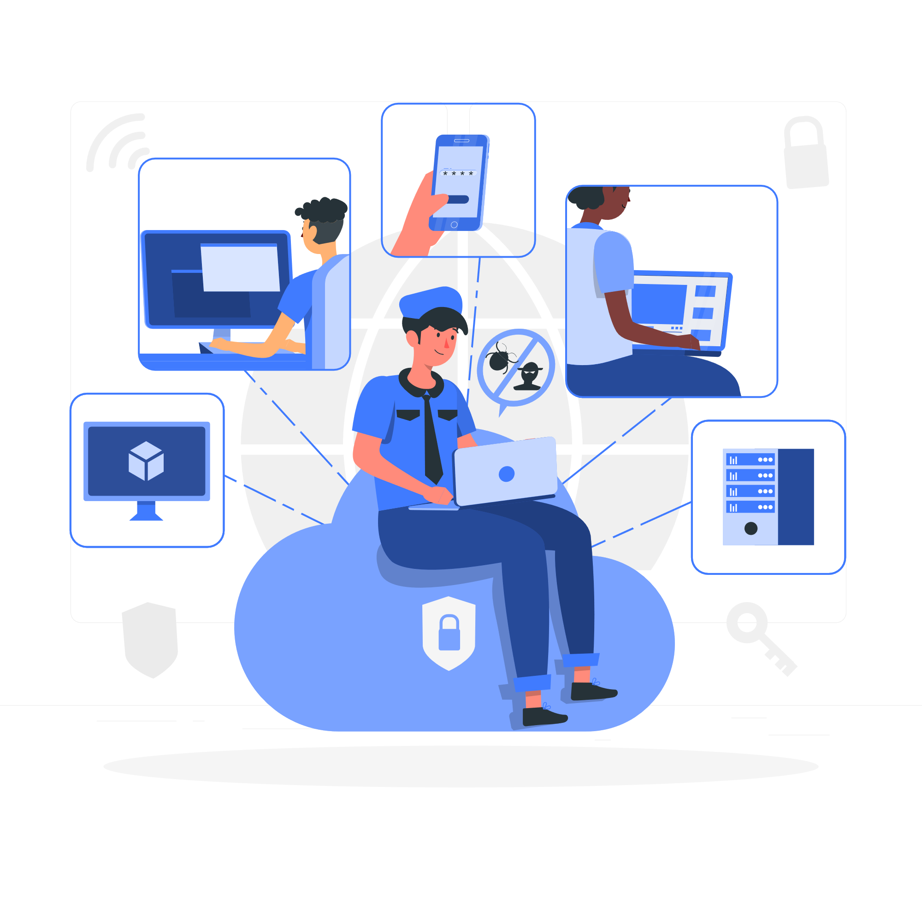
Privacy-Enhancing Technologies
“Privacy-Enhancing Technologies (PETs) are technologies that embody fundamental data protection principles by minimising personal data use, maximising data security, and/or empowering individuals.” - Information Commissioner’s Office*
Illustration by FreePik (https://storyset.com/)
*Source: “Chapter 5: Privacy-enhancing technologies (PETs)” (2022) by ICO (https://ico.org.uk/media/about-the-ico/consultations/4021464/chapter-5-anonymisation-pets.pdf)

Slide 4
Motivation
Lack of awareness
Complexity of the technologies
Regulations do not explicitly mandate the use of Privacy Enhancing Technologies
Lack of understanding and adoption of Privacy-Enhancing Technologies in the industry
→ Essential to address this issue to guarantee privacy and data sovereignty

Slide 5



Research Questions
What are the most prevalent PETs for data processing and analysis and what are their characteristics?
What are the benefits, challenges and applications of the selected PETs?
How can one convey this information in a meaningful and engaging manner to ensure a better understand-ding of the selected PETs?

Slide 6
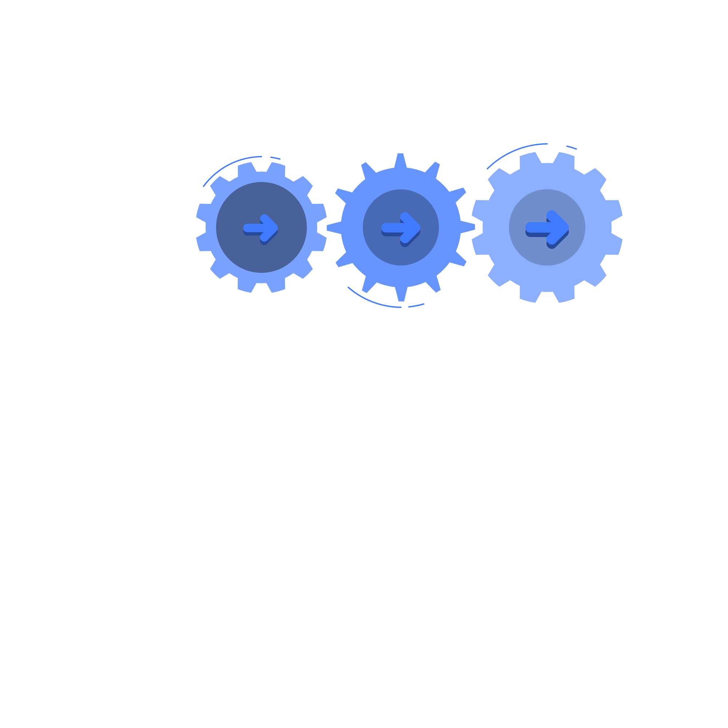
Methodology
Quantitative Analysis
Identify the predominant PETs through a quantitative analysis of existing literature
Systematic Literature Review
Conduct a systematic literature review to identify characteristics, benefits, and shortcomings of each PET
Learning Content
Create learning paths and a quiz based on the identified PETs

Slide 7
Quantitative Analysis
Specifications of Quantitative Analysis
Selected PETs for Quantitative Analysis
Scope of search
Search Timeframe: 2013 - Present
Publication Types: Conference papers, academic journals, and research articles
Search Method: Targeting "[PET]" in article titles, abstracts, and author keywords
Databases:
IEEE Xplore
Scopus
ACM Digital Library
ScienceDirect
Federated Learning
Differential privacy
Homomorphic encryption
Secure multi-party computation
Zero-knowledge proofs
Trusted execution environments
Privacy-preserving datamining
Private Information Retrieval
Pseudonymization
L-Diversity
T-Closeness

Slide 8
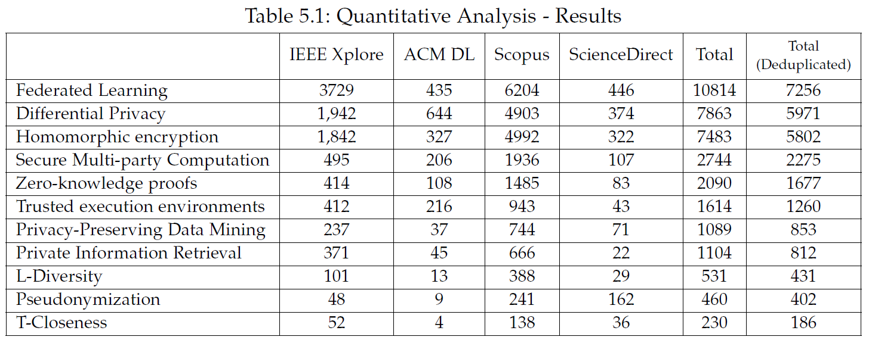
Quantitative Analysis: Results (1/2)

Slide 9
Quantitative Analysis: Results (2/2)

Slide 10
Quantitative Analysis: Results (2/2)

Slide 11
Systematic Literature Review
Search Methodology
Inclusion/Exclusion criteria
Databases:
IEEE Xplore
Scopus
ACM Digital Library
Search strategy:
Automated searches using search strings derived from the research question
  (”[PET]”)
  (”[PET]”) AND (”overview” OR “introduction” OR “basics” OR “fundamentals” OR “concepts” OR “principles”)
  (”[PET]”) AND (“applications” OR “benefits” OR “challenges”)
Inclusion criteria:
Papers have to be relevant and readily used in current literature (has to be published within the last 10 years)
Papers that talk about the characteristics, benefits and challenges of the PETs in context of data processing and analysis.
Exclusion criteria:
Papers focused on legal requirements or policies instead of the technologies
Papers that talk in detail about a very specific implementation or use case of a PET will not be considered
Papers that provide no useful information to a non-technical audience.

Slide 12
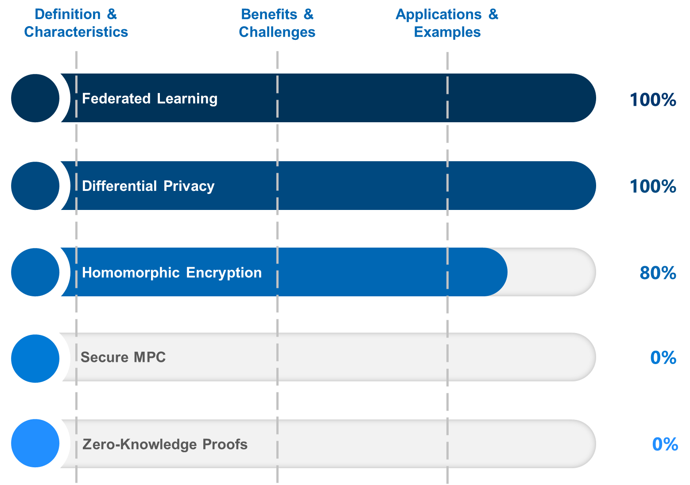
Systematic Literature Review: Results

Slide 13
Structure for each Privacy-Enhancing Technology
Set the context with SEBIS General Hospital's problem statement and the PET's role in resolving it
Provide a detailed definition of PET and discuss its unique aspects and characteristics
Present the benefits and challenges associated with this PET
Examine the broad range of industries and application areas
Share an example of a company that experienced a privacy breach, which could have been prevented by employing the PET
Showcase two successful implementation examples, highlighting the real-world effectiveness and applicability of the PET
Provide a brief explanation of the characteristics that make a problem ideal for applying this PET

Slide 14
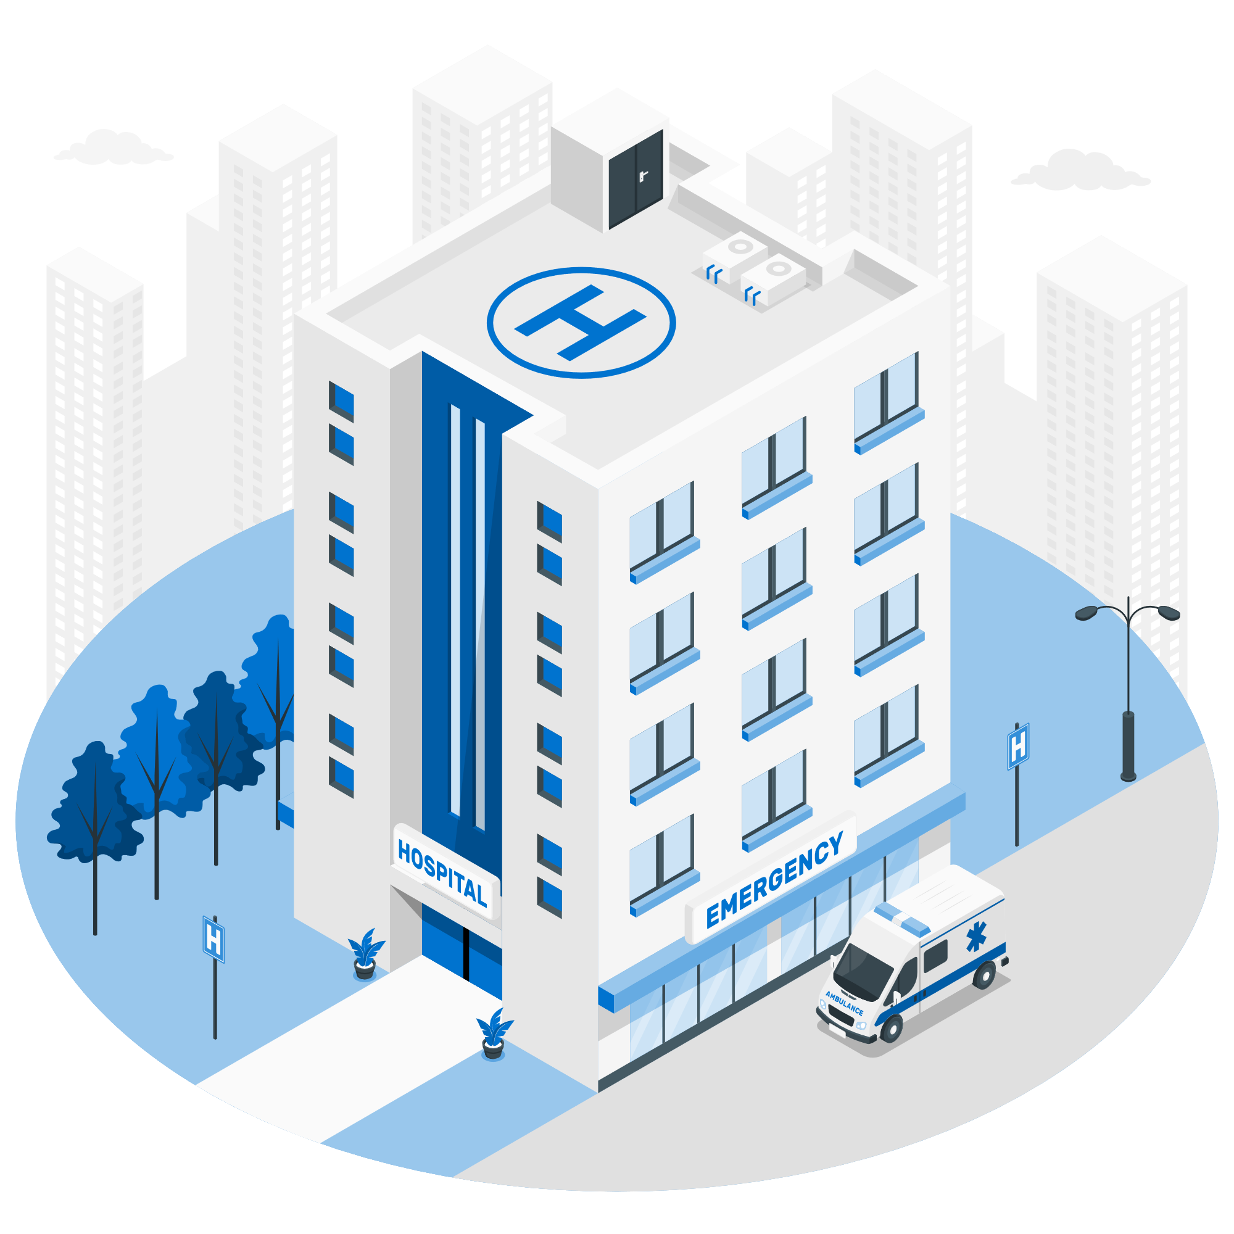

Example: Problem Statement – Federated Learning
Illustrations by FreePik
(https://www.flaticon.com/, https://storyset.com/)

Slide 15
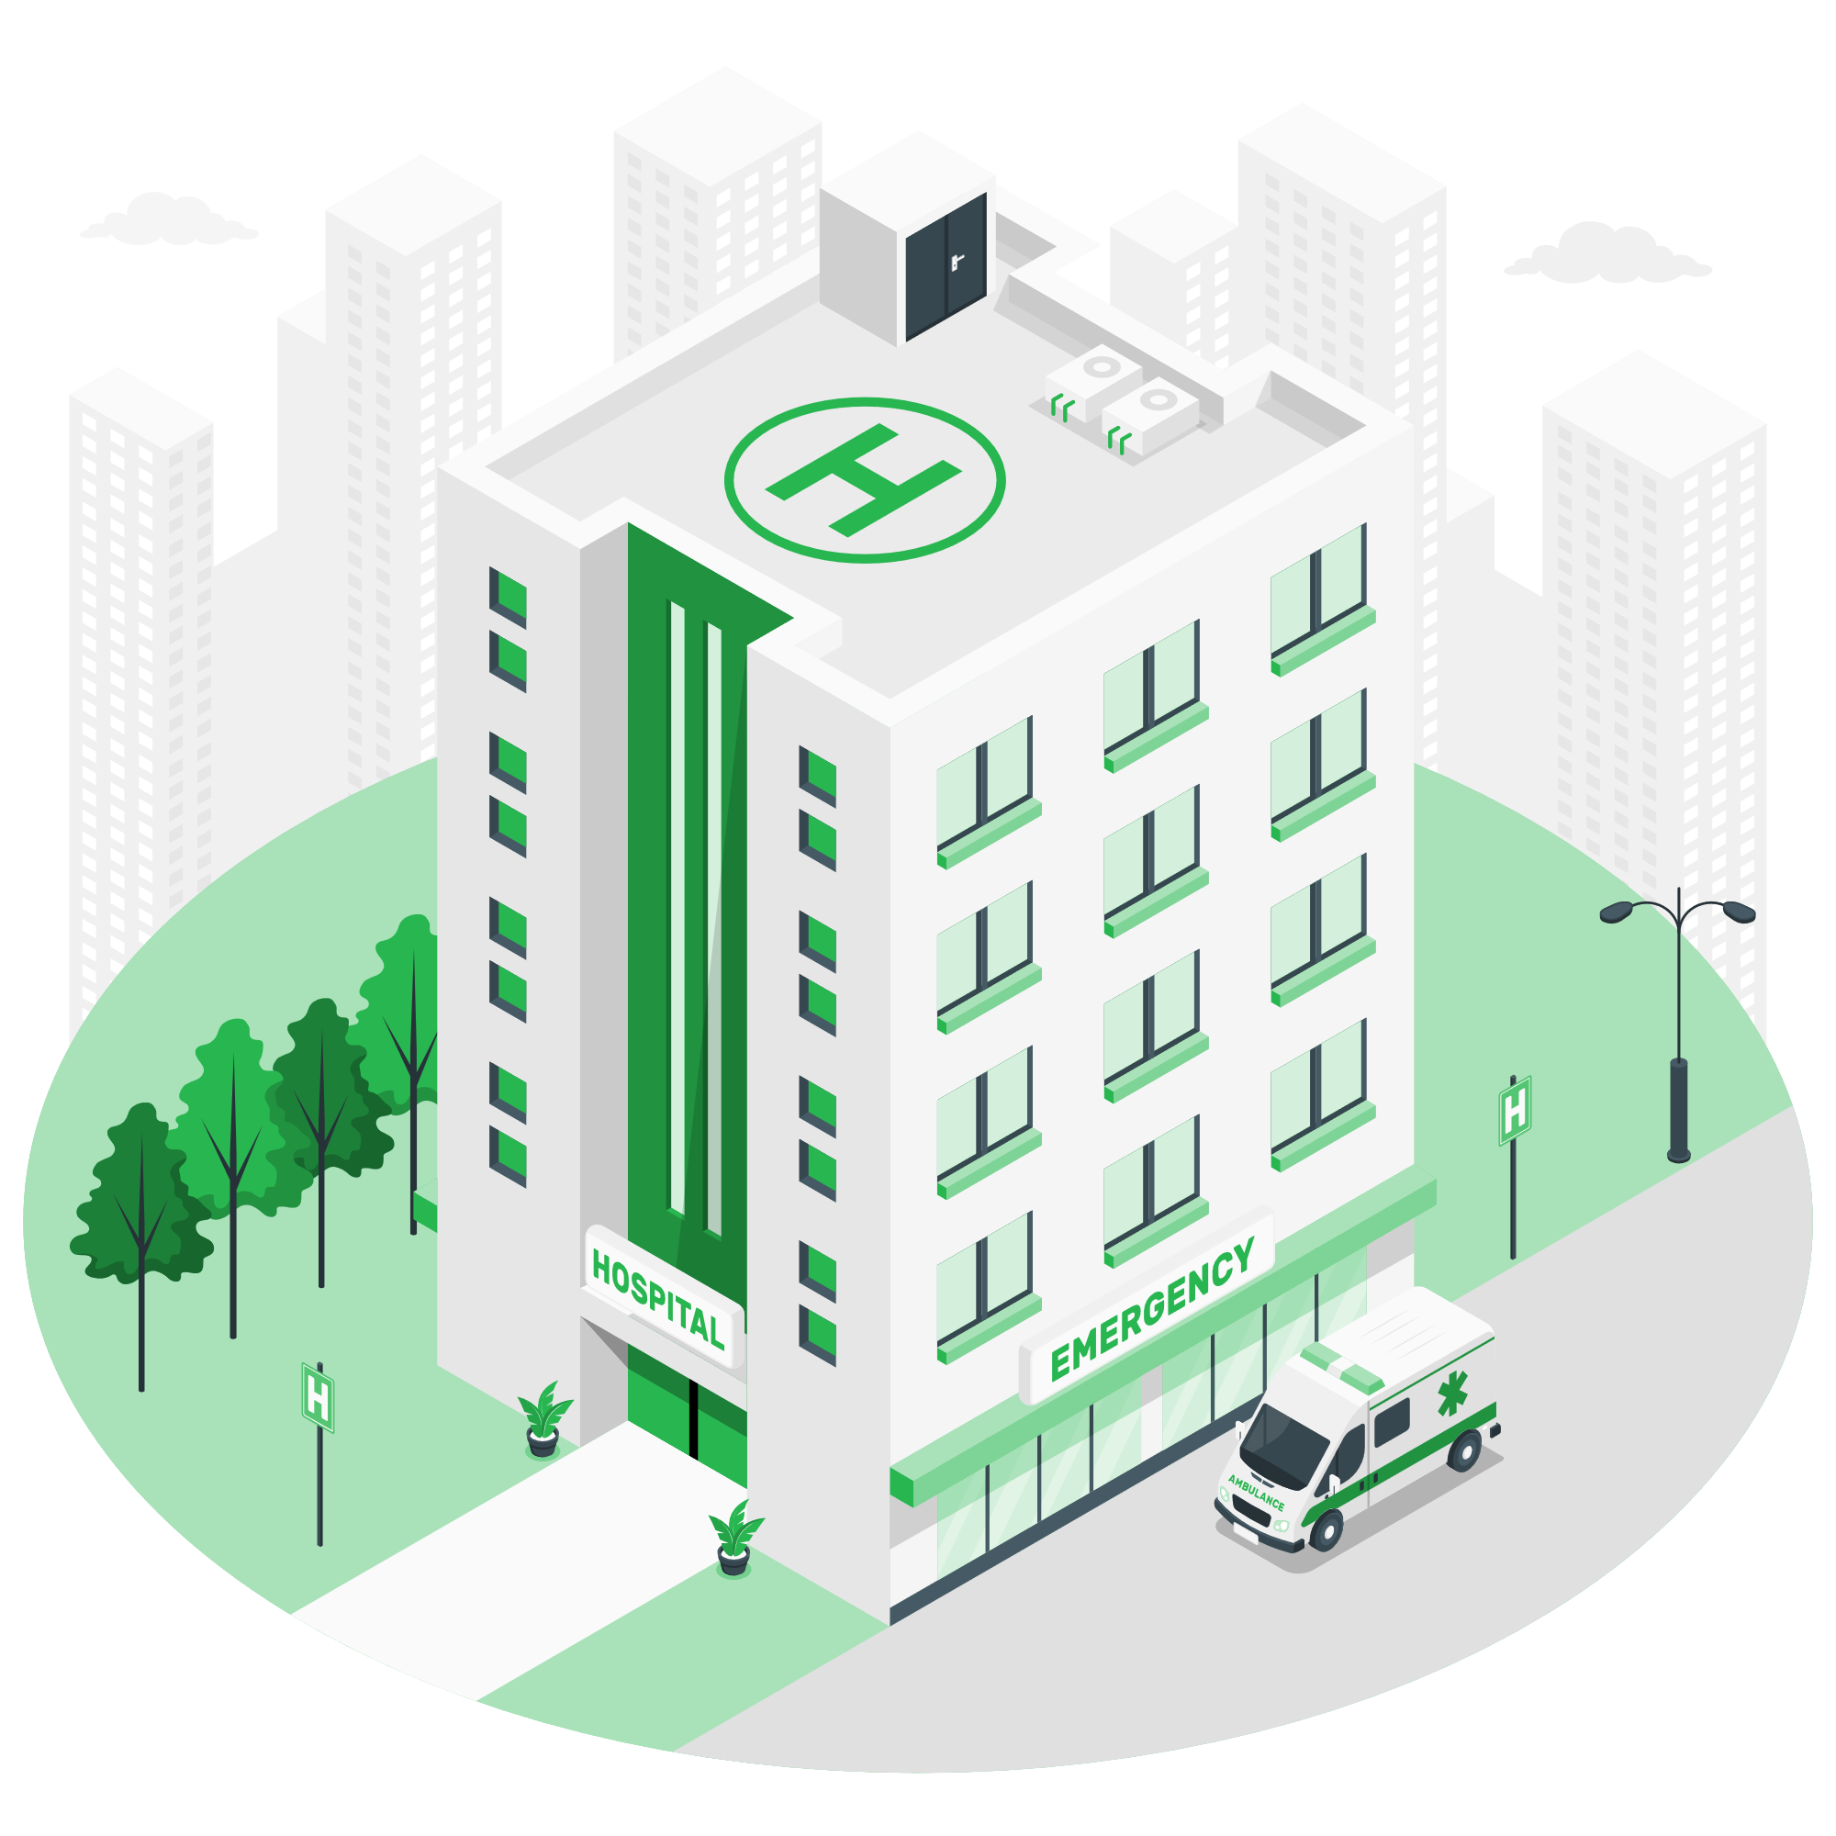

Example: Problem Statement – Federated Learning
Illustrations by FreePik
(https://www.flaticon.com/, https://storyset.com/)

Slide 16
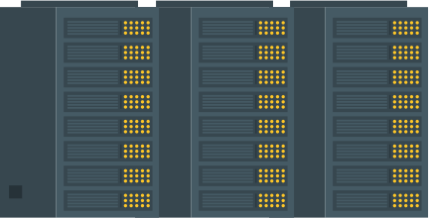

Example: Problem Statement – Federated Learning
Illustrations by FreePik
(https://www.flaticon.com/, https://storyset.com/)

Slide 17


Example: Problem Statement – Federated Learning
Illustrations by FreePik
(https://www.flaticon.com/, https://storyset.com/)

Slide 18
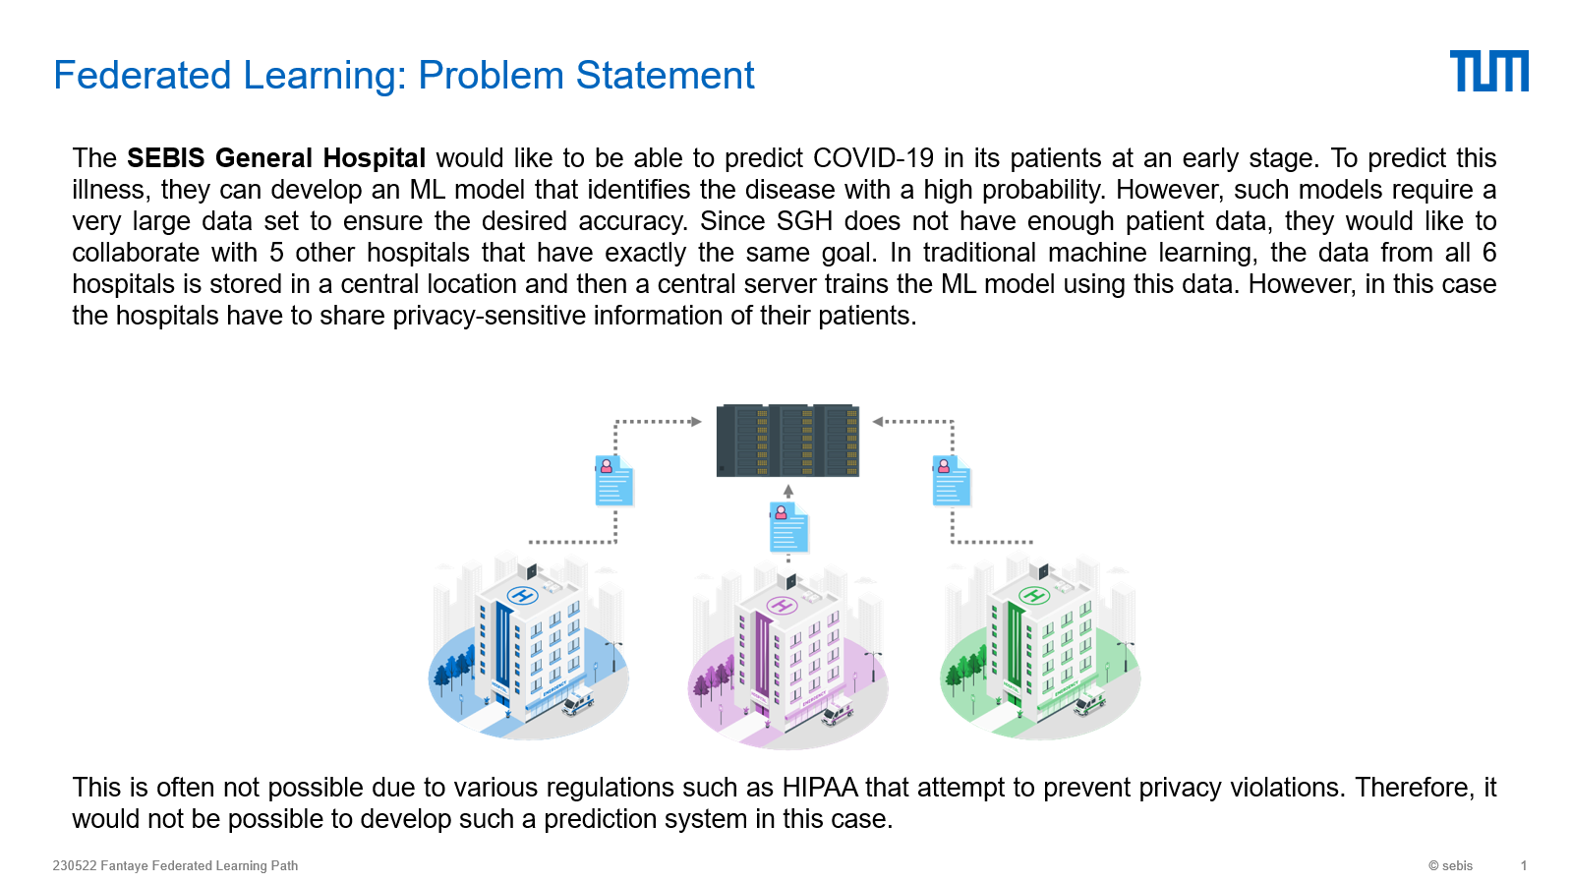
Outlook: Learning Content Development

Slide 19
Timeline
Today
 | March |  | April |  |  |  | May |  |  |  | June |  |  |  | July |  |  |  | Aug.
 | 1 | 2 | 3 | 4 | 5 | 6 | 7 | 8 | 9 | 10 | 11 | 12 | 13 | 14 | 15 | 16 | 17 | 18 | 19 | 20
Quantitative Analysis
Literature Review
Learning Paths
Writing

Slide 20
B.Sc. Candidate
Jared Fantaye
17132
matthes@in.tum.de

